Slide 1
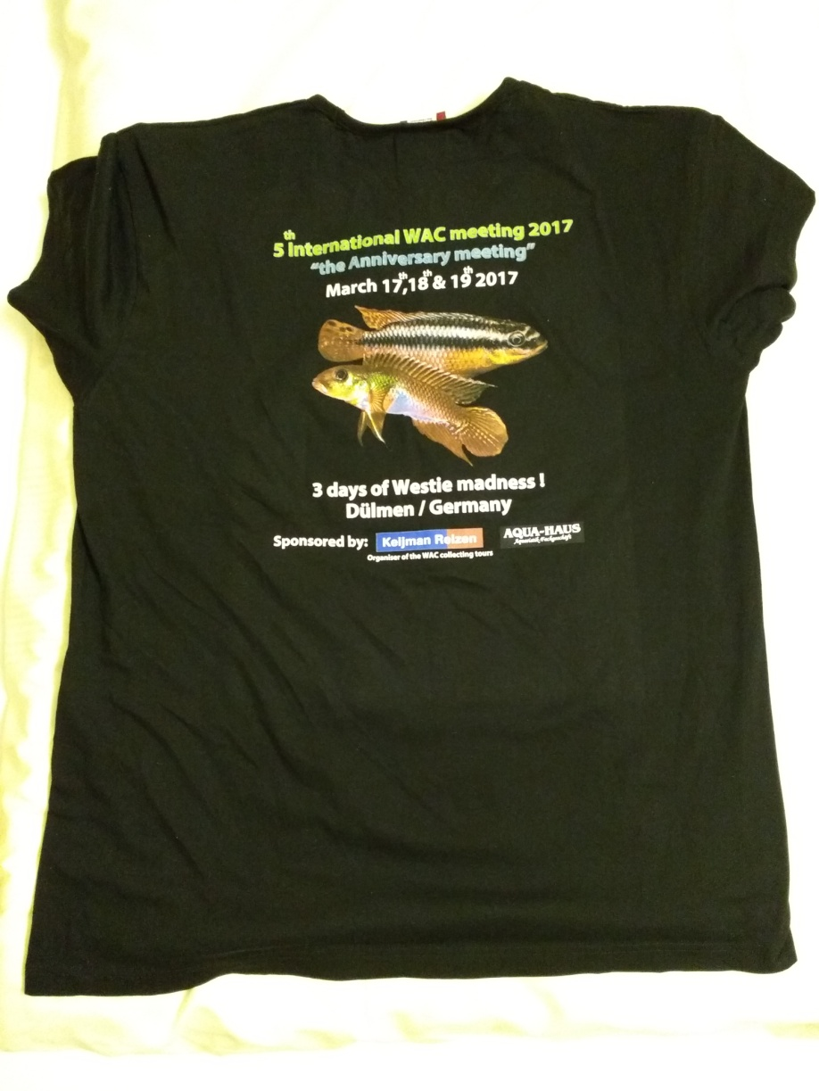
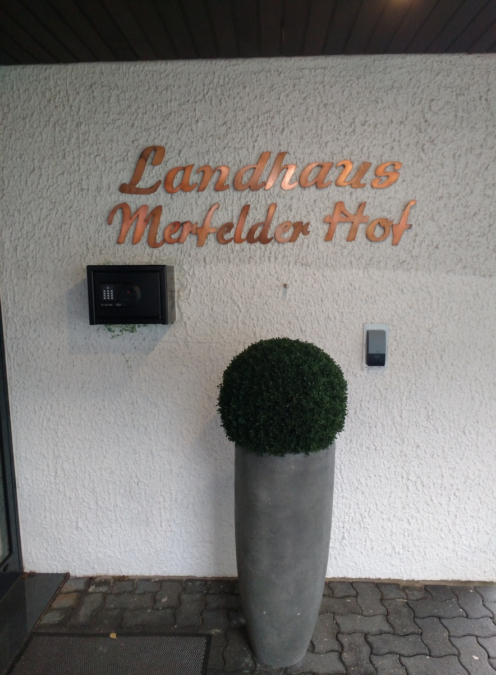
West African Cichlid Convention 2017, Dulmen Germany.

Slide 2
Sailing from Hull UK to Europort, Rotterdam, Holland.

Slide 3
1st stop en-route. Utaka, Amersfoort, Holland

Slide 4
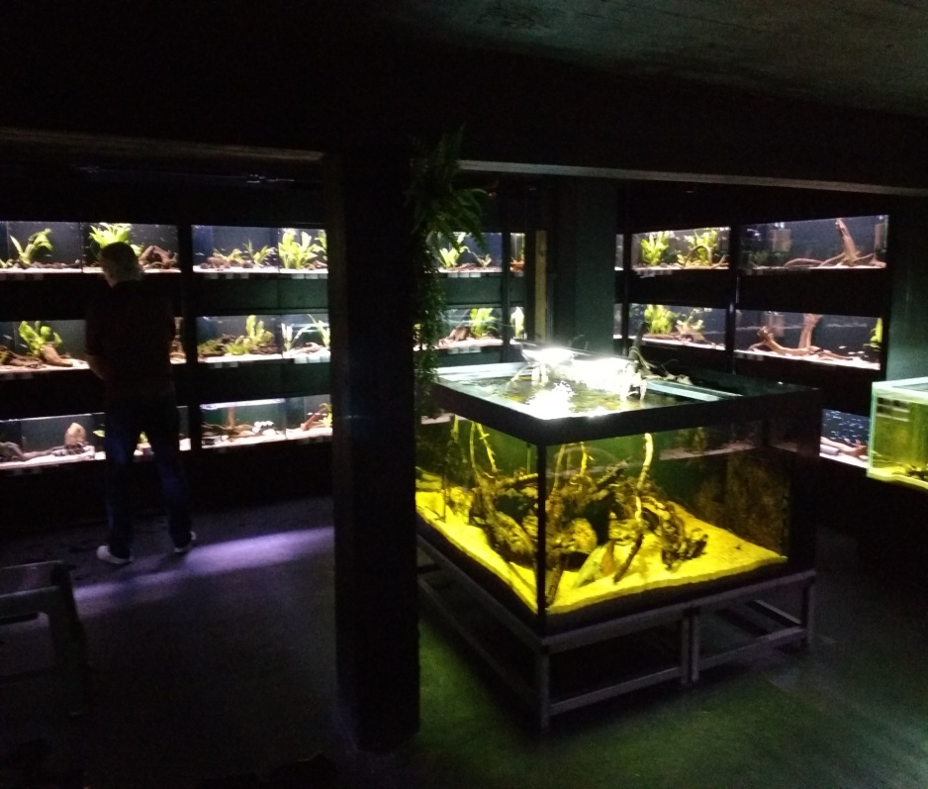
South American stuff in the cellers.

Slide 5
They really love Repashy I guess!

Slide 6
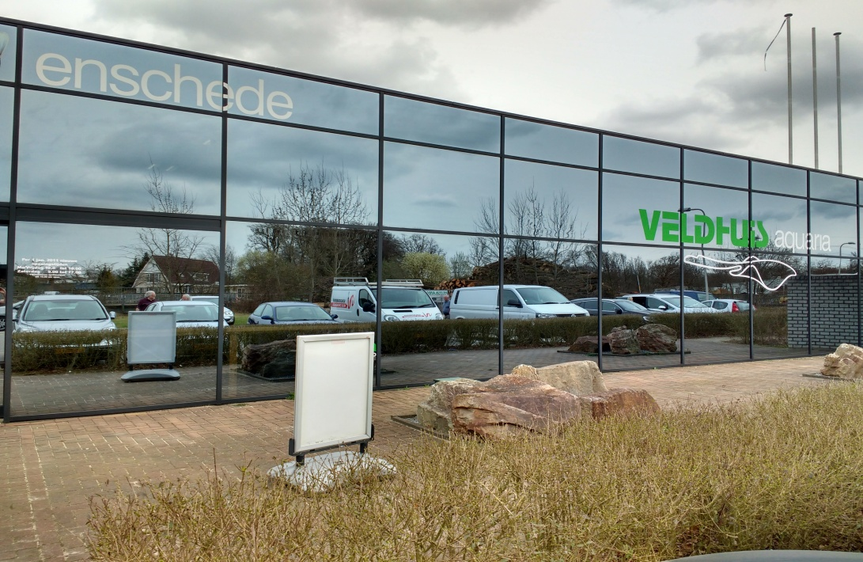
Velhuis Aquaria. Holland.

Slide 7
A room full of planted tanks

Slide 8
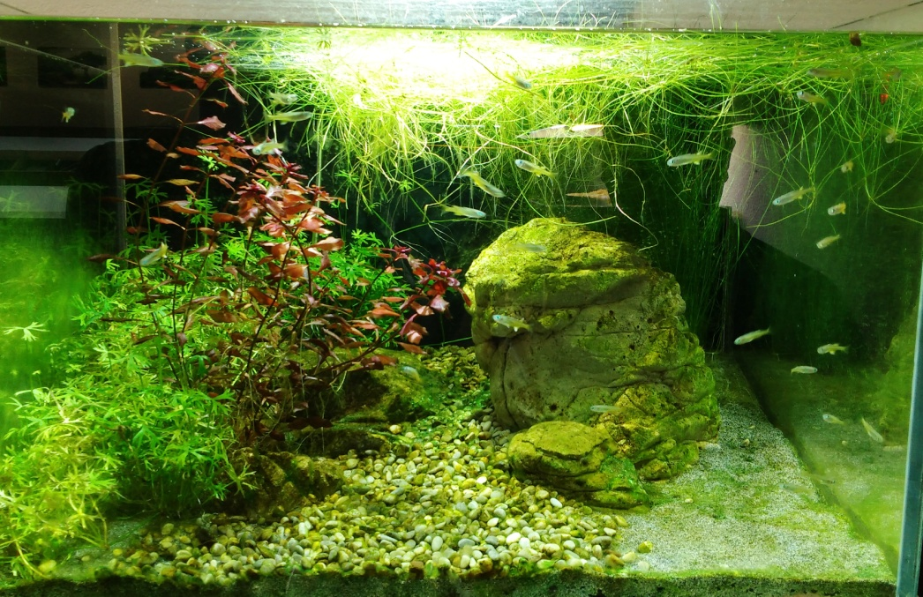
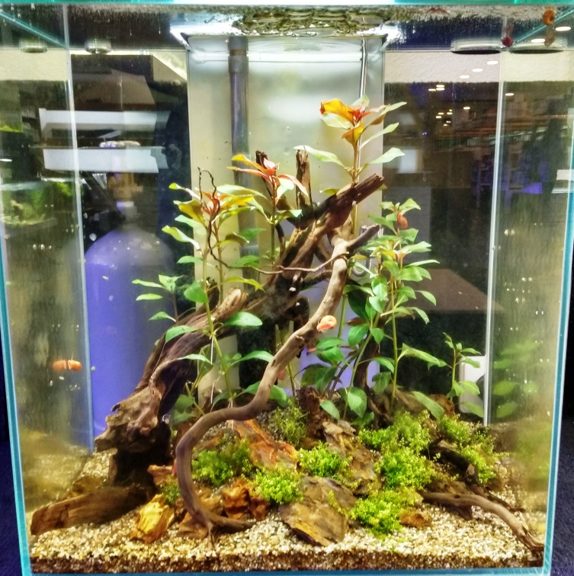

Slide 9
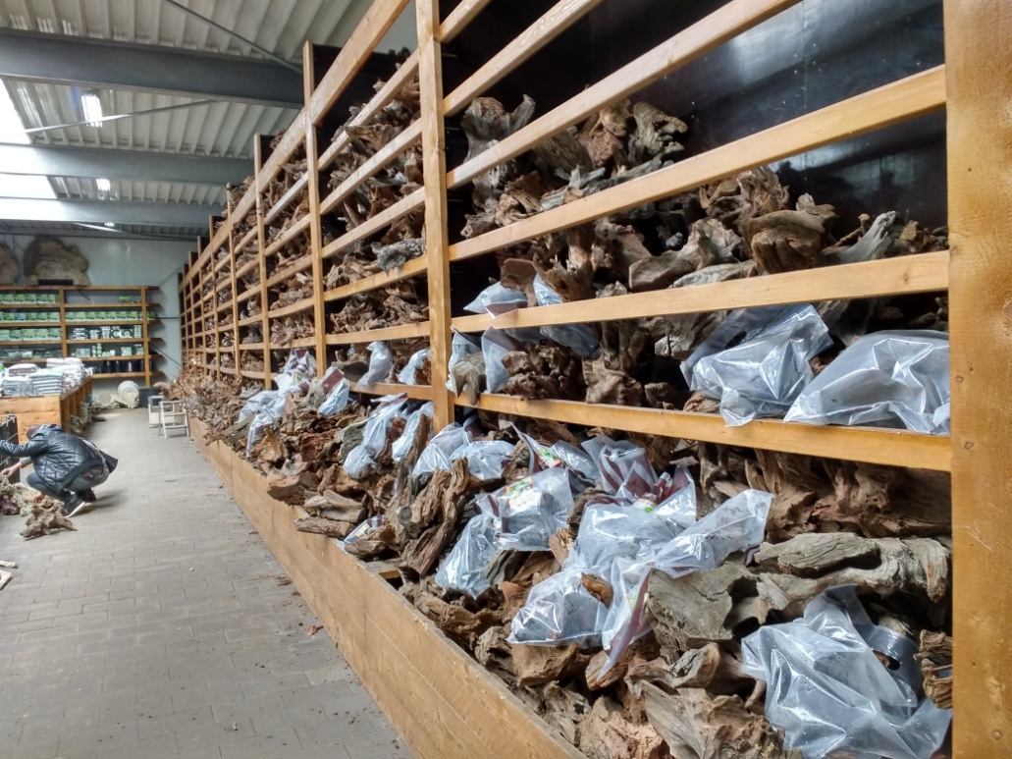
Just a bit of bogwood.

Slide 10
One of the most eccentric aquariums I have seen ... But great!

Slide 11
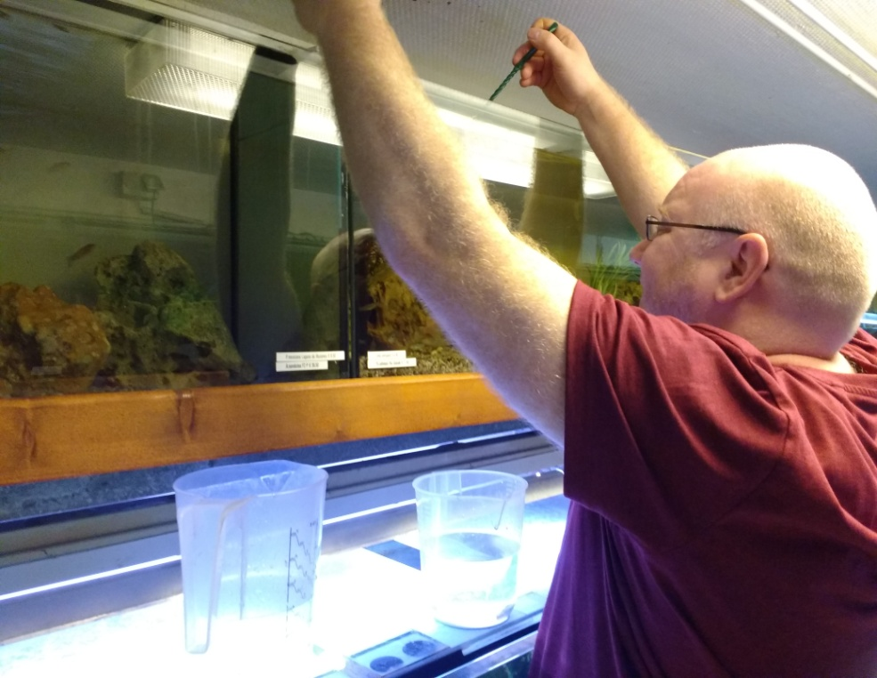
I even tried to get myself a job out there

Slide 12
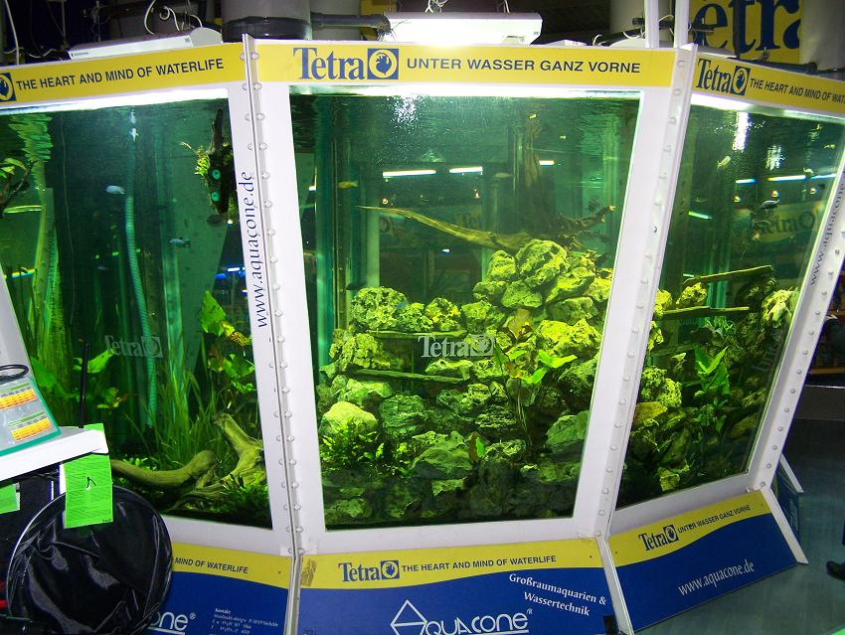
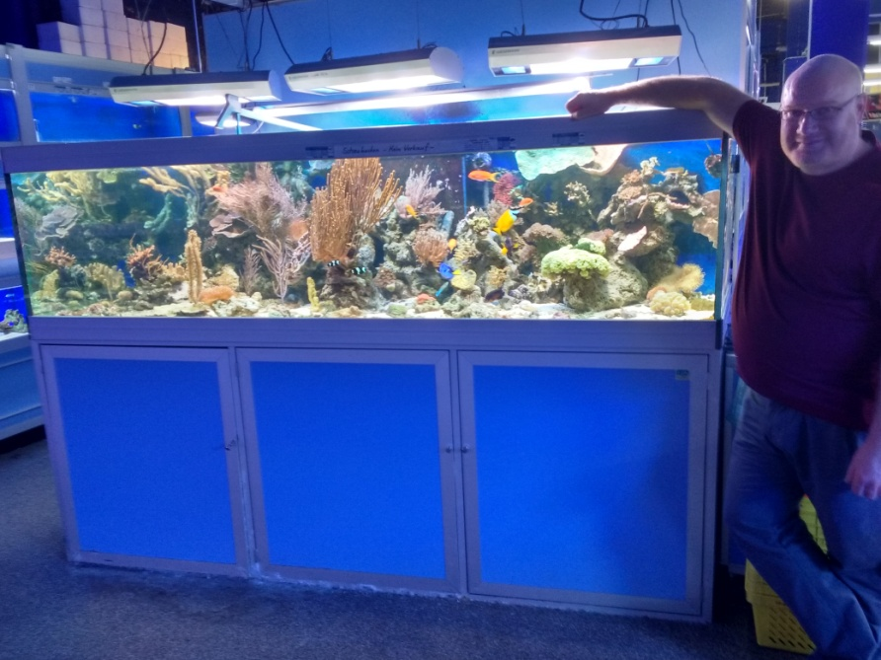
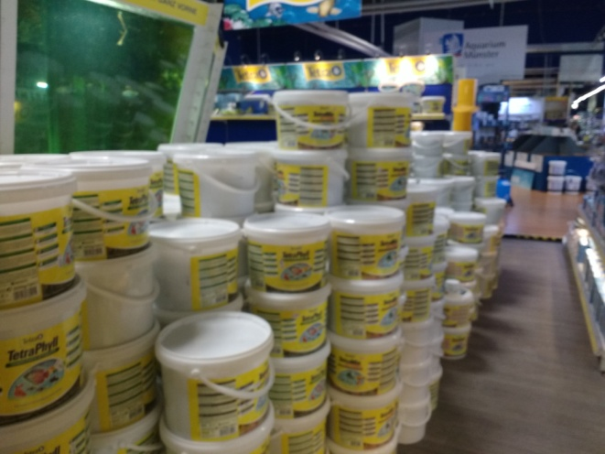
Supposed to be the biggest pet shop in the world. It is certainly massive!

Slide 13
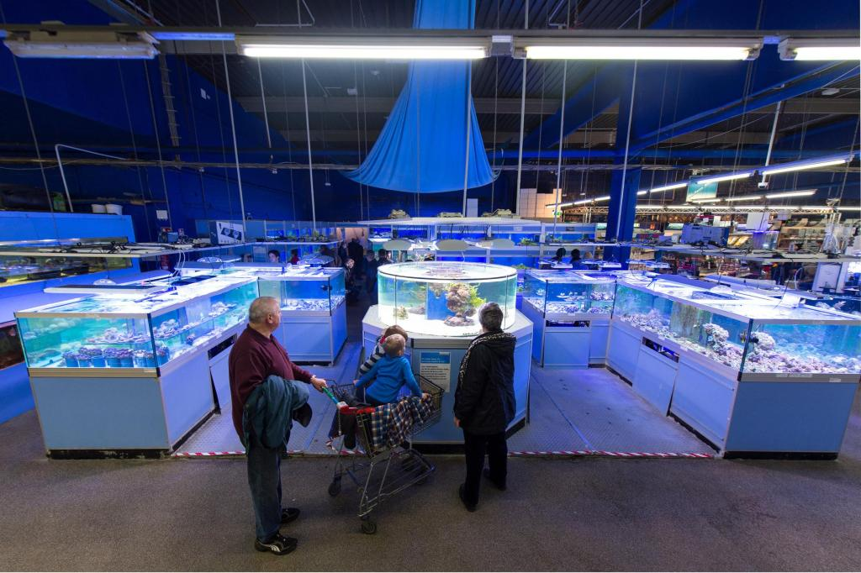
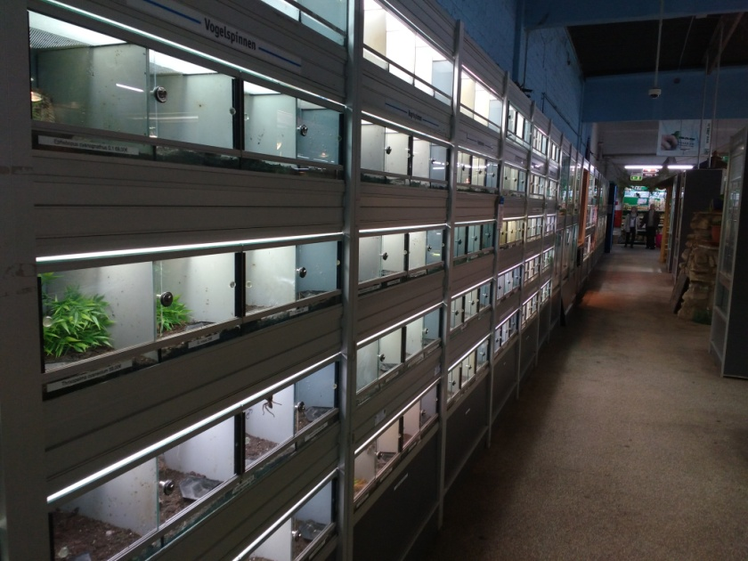
Rows and rows of fish, corals and terrestrial Inverts

Slide 14
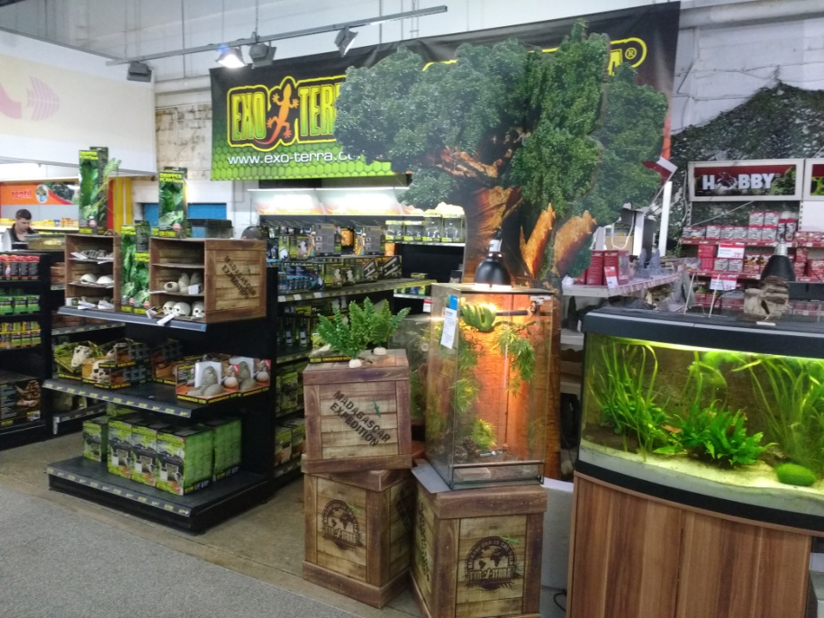
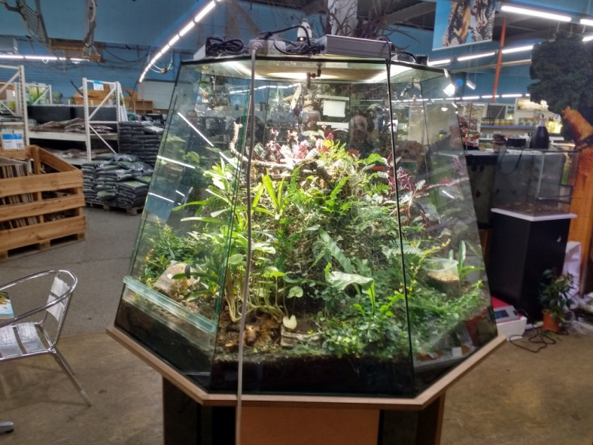
More Reptiles than anyone could cope with

Slide 15
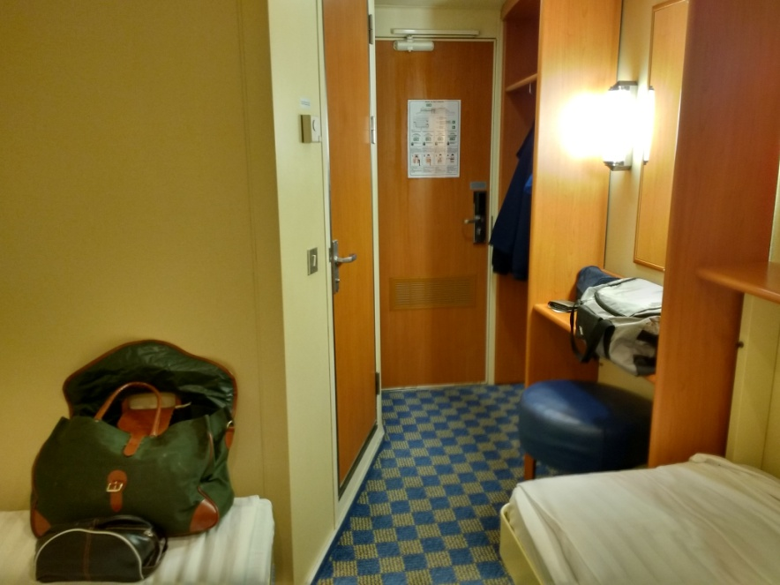
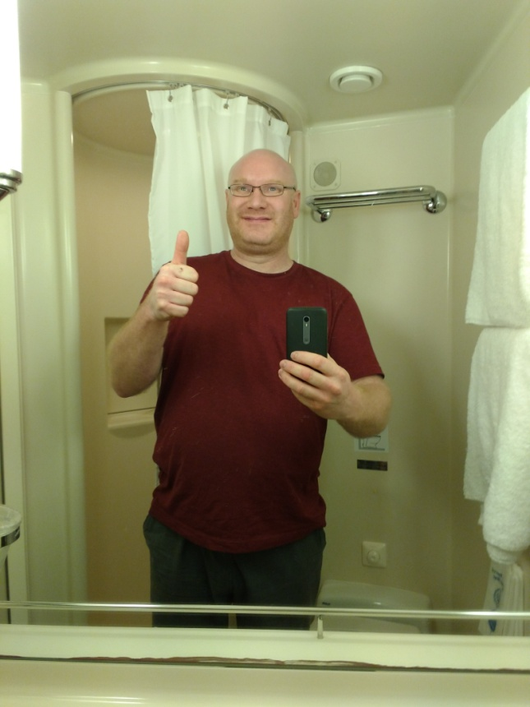
Sailing across the sea. Back to Fangs & Fins .. And family!

